Slide 1
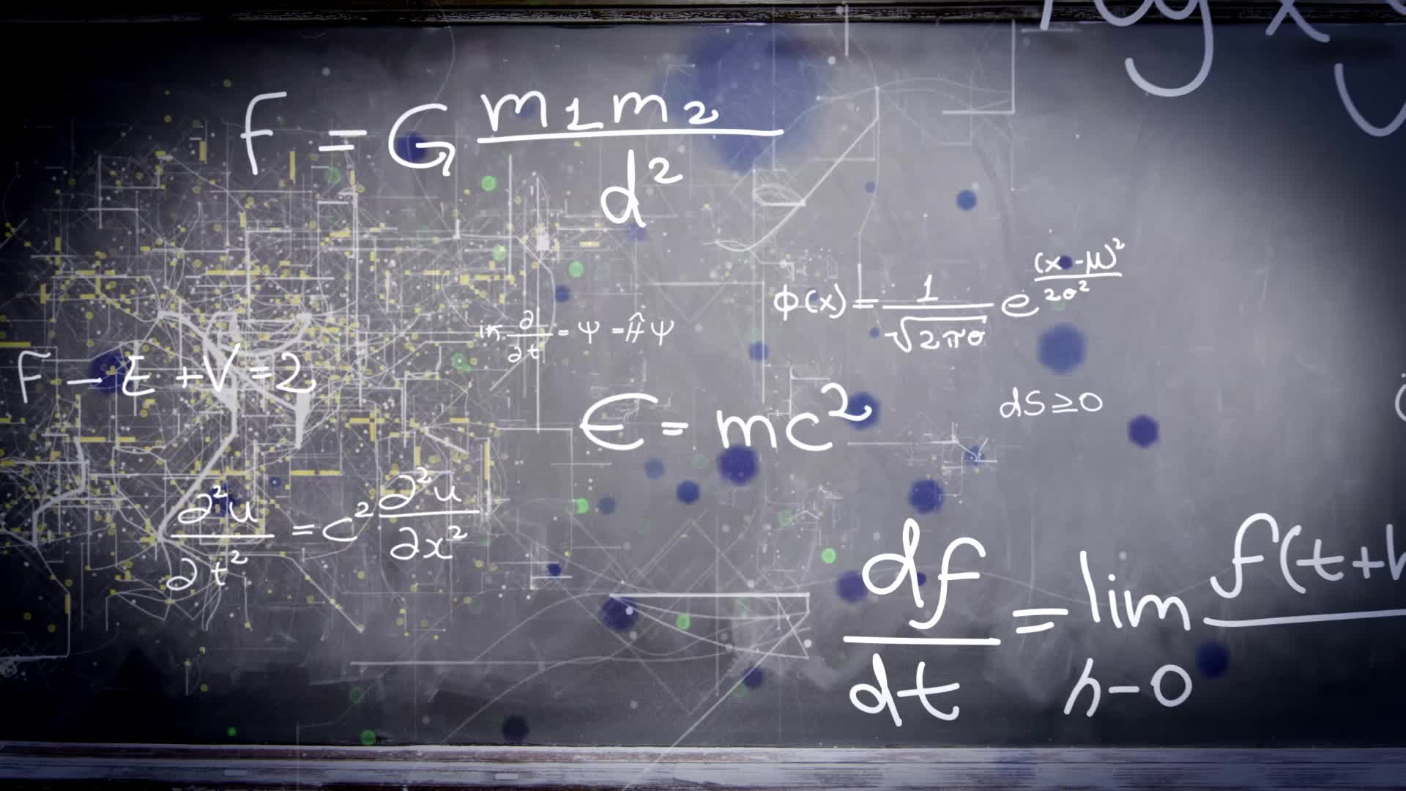
Chapter 3.3:
Increasing and Decreasing Functions and the First Derivative Test
HONORS CALCULUS/CALCULUS

Slide 2
Increasing and Decreasing Functions
A function is increasing on an interval if for any two numbers $x_{1}$ and $x_{2}$ in the interval $x_{1}<x_{2}$ implies $f\left(x_{1}\right)<f(x_{2})$.
A function is decreasing on an interval if for any two numbers $x_{1}$ and $x_{2}$ in the interval $x_{1}<x_{2}$ implies $f\left(x_{1}\right)>f(x_{2})$.

Slide 3
To find the open intervals on which f is increasing or decreasing, locate the CRITICAL NUMBERS in (a, b) and use them to determine the TEST INTERVALS.
Then determine the sign of $f′(x)$ at one value in each of the test intervals. Use the following guidelines to determine where f is increasing or decreasing:
If $f^{′}\left(x\right)>0 ∀ x∈\left(a,b\right), then f$is increasing on $\left(a,b\right).$
If $f^{′}\left(x\right)<0 ∀ x∈\left(a,b\right), then f$is decreasing on $\left(a,b\right).$
If $f^{′}\left(x\right)=0 ∀ x∈\left(a,b\right), then f$is constant on $\left(a,b\right).$

Slide 4
Ex. 1) $f\left(x\right)=x^{3}−\frac{3}{2}x^{2}$

Slide 5
Ex. 2) $f\left(x\right)={\left(x^{2}−4\right)}^{\frac{2}{3}}$

Slide 6
Ex. 3) $f\left(x\right)=\frac{x^{4}+1}{x^{2}}$

Slide 7
The First Derivative Test For Relative Extreme Values
If $f′(x)$ changes from POSITIVE TO NEGATIVE at c ($f^{′}\left(x\right)>0$ for $x<c$ and $f^{′}\left(x\right)<0$ for $x>c$), then f has a RELATIVE MAXIMUM value at c.
If $f′(x)$ changes from NEGATIVE TO POSITIVE at c ($f^{′}\left(x\right)<0$ for $x<c$ and $f^{′}\left(x\right)>0$ for $x>c$), then f has a RELATIVE MINIMUM value at c.
If $f′(x)$ DOES NOT CHANGE SIGN at c ($f^{′}\left(x\right)$ has the same sign on both sides of c), then f has no local extreme value at c.
At a left endpoint a:
If $f^{′}\left(x\right)<0 (f^{′}\left(x\right)>0)$ for $x>a$, then f has a RELATIVE MAXIMUM (MINIMUM) value at a.
At a right endpoint b:
If $f^{′}\left(x\right)<0 (f^{′}\left(x\right)>0)$ for $x<b$, then f has a RELATIVE MINIMUM (MAXIMMUM) value at b.

Slide 8
Ex. 1) For each problem, (a) find the critical numbers of (if any), (b) find the open interval(s) on which the function is increasing or decreasing, (c) apply the First Derivative Test to identify all relative extrema.
$f\left(x\right)=x^{2}−6x+11$

Slide 9
Ex. 2) For each problem, (a) find the critical numbers of (if any), (b) find the open interval(s) on which the function is increasing or decreasing, (c) apply the First Derivative Test to identify all relative extrema.
$f\left(x\right)={\left(x−5\right)}^{\frac{2}{3}}$

Slide 10
Ex. 3) For each problem, (a) find the critical numbers of (if any), (b) find the open interval(s) on which the function is increasing or decreasing, (c) apply the First Derivative Test to identify all relative extrema.
$f\left(x\right)=x^{5}+2x^{3}−4$

